Slide 1


SMART INDIA HACKATHON 2025
TITLE PAGE
Problem Statement ID – SIH25106
Problem Statement Title-
Internship/Industrial Training with Placement Opportunity
Theme-Smart Education
PS Category- Software
Team ID-112408
Team Name - CODE-2-CAREER

Slide 2

IDEA TITLE
CODE-2-CAREER
“SkillConnect enables smart matching of students to campus placement opportunities.”
Solution :
Explanation:
A one-stop platform for internships and placements. Single student profile for all applications, one-click apply to verified openings, mentor approvals with automated certificates, and real-time dashboards for tracking students and interviews.
Innovation and Uniqueness :
Smart recommendation engine matches students with best-fit roles.
Role-based, privacy-first access for employers & stakeholders.
Low-cost, scalable MERN solution, replacing scattered emails, WhatsApp groups & spreadsheets.

Slide 3
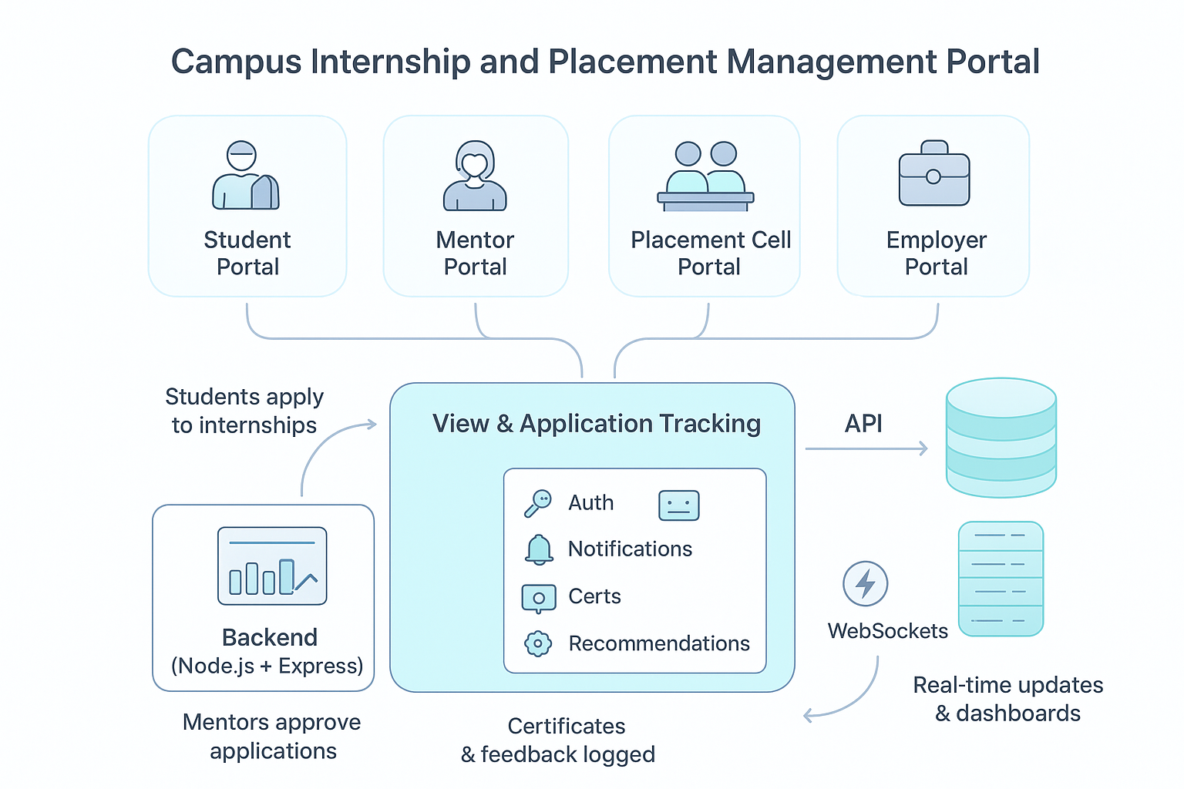
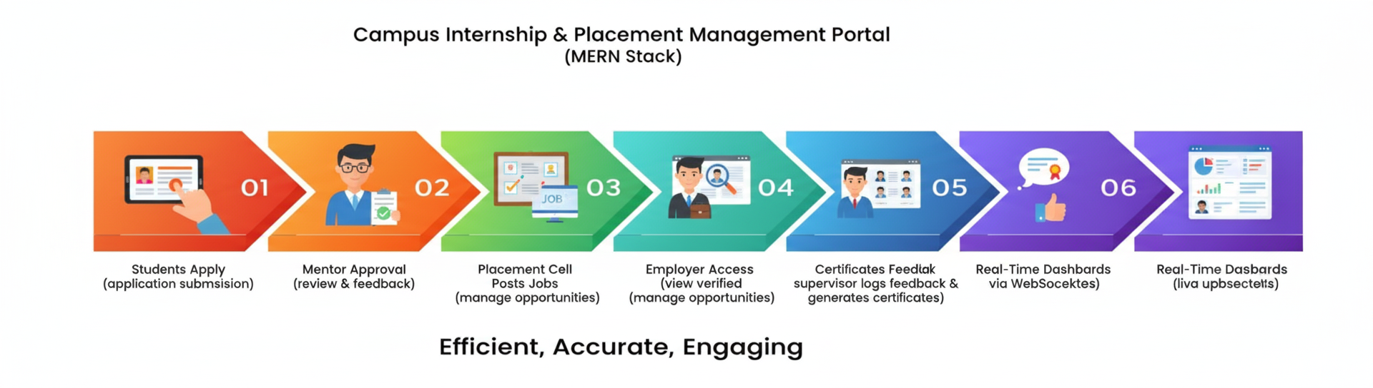

TECHNICAL APPROACH
CODE-2-CAREER
Core Workflow :
Students apply for internships via the portal, mentors approve, and placement officers post opportunities, all managed through APIs with real-time updates. Employers access verified student profiles, while feedback and certificates are logged, ensuring a seamless end-to-end placement workflow.
Technology Stack and Version Control & Collaboration :

Slide 4

FEASIBILITY AND VIABILITY
CODE-2-CAREER

Slide 5
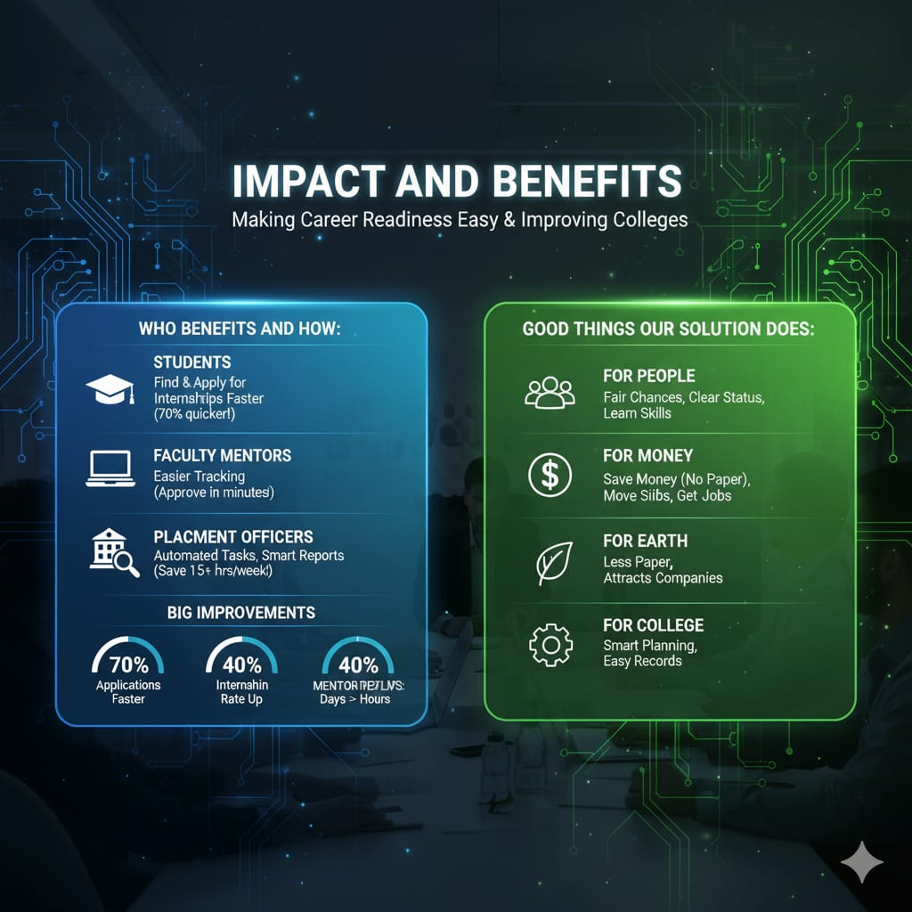
CODE-2-CAREER

Slide 6
RESEARCH AND REFERENCES
CODE-2-CAREER
Musambya Mutambala, Gussai Sheikheldin, Bitrina Diyamett, & Bavo Nyichomba. Student Industrial Secondments in East Africa: Improving Employability in Engineering. 2020 IFEES World Engineering Education Forum – Global Engineering Deans Council (WEEF-GEDC).
Maman Somantri, & Resa Pramudita. Enhancing Industry's Role in Vocational Education: An Analysis of Challenges and Opportunities Based on a Literature Review. 2024 9th International STEM Education Conference (iSTEM-Ed).
D. Shyam Prakash, Sarumathi KM, Dhanashree R, Sachin Samuel R, & Preetham Murthy B. An Integrated Web-Based Platform for Enhanced College Placement Management and Student Engagement. 2024 10th International Conference on Advanced Computing and Communication Systems (ICACCS).

